Slide 1

Collection
CitiusTech has prepared the content contained in this document based on information and knowledge that it reasonably believes to be reliable. Any recipient may rely on the contents of this document at its own risk and CitiusTech shall not be responsible for any error and/or omission in the preparation of this document. The use of any third party reference should not be regarded as an indication of an endorsement, an affiliation or the existence of any other kind of relationship between CitiusTech and such third party

Slide 2
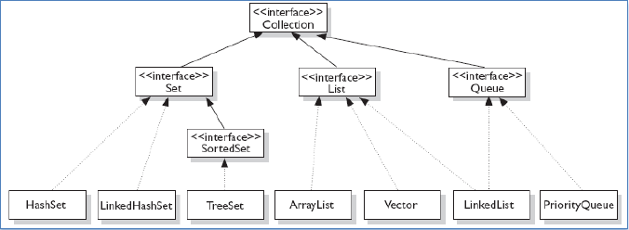
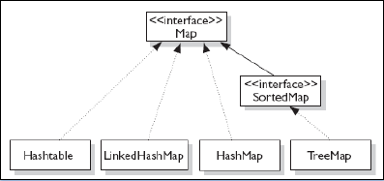

Slide 3
import java.utill…….
Collection ( Topmost Interface )
Set (Interface that implements Hashing )
SortedSet ( Interface that implements Balance Search Tree )
List (Interface that implements Doubly Link List)

Slide 4
Map (Interface) //store the data in key/value format
extends
Sorted Map (Interface)// store the data in key/value format (sorted order)

Slide 5
Traversal in collection 1
Iterator (Interface that is attached with Collection to traverse in a collection .) - Boolean hasNext() // terurns true if there are more elements, Otherwise False.
Object next() // return the next element throws NoSuchElementsException .
void remove() // remove the current element throws IllegalStateException .
Note : can traverse in single direction.

Slide 6
Traversal in collection 2
ListIterator (Interface that extends Iterator and can use with the Collection that implements List.
Boolean hasNext() //Retrurns true if ther are more elements, Otherwise False.
Boolean hasPrivious() //Retrurns true if ther are more elements, Otherwise False.
Object next() // Returns the next object throws NoSuchElementsException .
int nextIndex() // Returns the index of the next elements.
int previousIndex() // Returns the index of the previous elements.
Note : can traverse in both direction.

Slide 7
Collection Interfaces 1
Collection :
void clear() //clear all the elements from the invoking collection
int size() //return the number of elements
Boolean add (Object ob) //return true if added , false if alredy member or duplicates are not allowed by collection.
Boolean remove (Object ob) //remove one instance of ob
Boolean contains (Object ob) //return true if ob is an part of invoking collection.
Boolean addAll (Collection c) //add all the element of c.

Slide 8
Collection Interfaces 2
Boolean removeAll (Collection c) //remove all elements of c from invoking collection .
Boolean containsAll (Collection c) //return true if invoking collectio contains all elements of c.
Object[ ] toArray () // returns an array containing all the elements stored in invoking collection.
Object[ ] toArray (Object ob[ ]) // returns an array containing only those elements whose type matches that of array..
Iterator iterator() returns the iterator for invoking collection.

Slide 9
Set & SortedSet Interface
Set – ( represents collection of unique elements ) no new method…
SortedSet – (represents collection of unique elements stored in some order)
Object first() // returns the first elements in the invoking Sorted Set.
Object last() // returns the last elements in the invoking Sorted Set
SortedSet headSet(Object end) //return a SortedSet containing those elements less than end.
SortedSet trailSet(Object start) //return a SortedSet containing those elemen geater than start
SortedSet subSet(Object start, Object end) // returns a SortedSet that include those elements between start and end.

Slide 10
List Interface 1
List – ( represents collection of non unique elements )
void add (int index, Object ob) // Insert ob at the index
Object get (int index) // return an object stored at the specified index.
Object remove (int index) //remove & return an object stored at the specified index.
Boolean addAll (int index ,Collection c) //add all the elements of c at the index.
int indexOf(Object ob) //returns the index of the first instance of ob .if ob is not the an element of the list ,-1 is returned.

Slide 11
List Interface 2
int LastIndexOf(Object ob) //returns the index of the last instance of ob .if ob is not the an element of the list ,-1 is returned.
ListIterator ListIterator() // return an iterator for invoking List .
ListIterator ListIterator( int index) // return an iterator for invoking List that begins at the index.
Object set (int index,Object ob)//Assign ob to the location at index
List subList (Int start,int end) // return an list form strat to end -1

Slide 12
Map Interface 1
Define operations for maintaining and mapping key/value
Void clear() //remove all key/value pairs
Boolean containsKey (Object key) //Returns true if the invoking Map contains key
Boolean containsValue (Object value) // //Returns true if the invoking Map contains value.
Set entrySet () //returns a Set that contains the entries in the map.The set contains object of type Map.Entry
Boolean equals(Object ob) // returns true if obj is a Man and contains some enrty.
Object get(Object k) //Returns the value associated with the key.

Slide 13
Map Interface 2
Int hashCode() // return hash code for invoking map.
Boolean isEmpty(0 //returns true if Map is empty
Set keySet () // Returns the map that contains key in the invoking map .
Object put (Object key, Object value) // put the entry. Overwrite the privious value associated with key
void putAll(Map m) // put all entries from m.
Object remove(Object k) // remove the entry whose key is k
int size() //returns the number of key/vaylue pair .
Collection values() //returns a collection containing the values in the map.

Slide 14
SortedMap Interface
Object firstKey() // return the first key in the map
SortedMap headMap(Object end) // Return a SortedMap for the entry with key less than end.
Object lastKey() // return the last key
SortedMap subMap (Object Start, Object End) // Return a SortedMap for the entry with key less than End .and greater than or equals to start.
SortedMap tailMap (Object Start ) // Return a SortedMap for the entry with key greater than or equals to start

Slide 15
Classes 1
Set
HashSet // in place of ArrayList but duplicates are not allowed
HashSet()
HashSet ( Collection c) //initialized with c)
HashSet (int capacity)
LinkedHashSet extends HashSet have only a default constructer.
SortedSet
TreeSet
TreeSet()
TreeSet(Collection c) //initialized with c
TreeSet(SortedSet ss)

Slide 16
Classes 2
List
ArrayList
ArrayList()
ArrayList(Collection c) //initialized with c
ArrayList(int capacity)
Vecter //Thread safe
Vector()
Vector(int size)
Vector(int size , int icrmnt)
Vector(Collection c)
LinkList
LinkedList()
LinkedList(Collection c) //initialized with c

Slide 17
Classes 3
Map
HashMap
HashMap ()
HashMap (Map ob) //Initialized with Map
HashMap ( int capacity)
HashMap (int capacity,Float fill_ratio)
HashTable //thread safe
Hashtable()
Hashtable(Map ob) //Initialized with Map
Hashtable(int capacity,Float fill_ratio)
LinkedHashMap
LinkedHashMap ()
LinkedHashMap (Map m)
LinkedHashMap (int capacity)
LinkedHashMap (int cap,float fill_ratio)
Notes:
Ordering and Sorting
HashMap doesn't provide any ordering guarantee for entries, which means, you can not assume any order while iterating over keys and values of HashMap. This behavior of HashMap is similar to Hashtable while other two Map implementation provides ordering guarantee. LinkedHashMap can be used to maintain insertion order, on which keys are inserted into Map or it can also be used to maintain an access order, on which keys are accessed. This provides LinkedHashMap an edge over HashMap without compromising too much performance. TreeMap provides you complete control over sorting elements by passing custom Comparator of your choice, but with the expense of some performance. Since entries are stored in a tree-based data structure, it provides lower performance than HashMap and LinkedHashMap.

Slide 18
Classes 4
SortedMap
TreeMap
TreeMap ()
TreeMap (Map m)
TreeMap (SortedMap sm)

Slide 19
Agenda for Selecting Classes
Ordered / non ordered
Duplicates allowed / unique
Synchronized / Not Synchronized

Slide 20
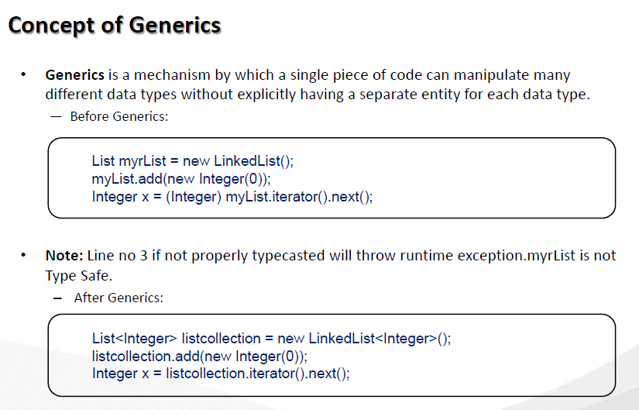

Slide 21
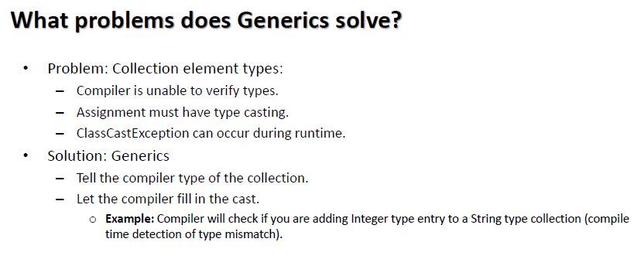

Slide 22
